Slide 1

Code Refactoring and Bug Fixing
by- R.Gautam Kumar

Slide 2
Scenario
A team of enthusiastic data scientists embarked on a mission to develop a Note Taking application using Python, Flask, and HTML. However, their lack of experience in backend development has led to challenges in making the application fully functional. Recognizing yourproficiency in backend development, you have been tasked with fixing the broken code and ensuring the application works seamlessly.
Task
Refactor the existing codebase and ensure the proper functioning of the Note Taking Application. Document all identified bugs during the debugging process. Remember, the task is not about recreating the app from scratch. Your goal is to fix the already existing codebase and make the application work as intended.

Slide 3
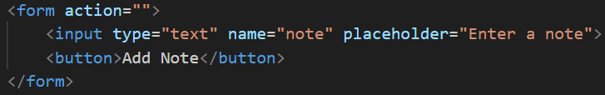
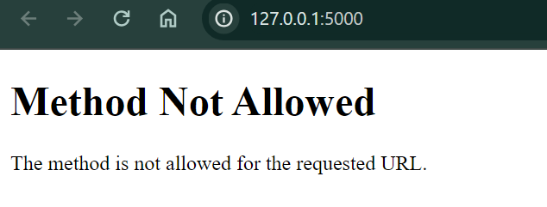
Identifying and Resolving the Bugs in the Initial Code
The following code snippets represents the initial state of Flask Application. The figure below figures contain identifiable Bugs , which is Impacting the functionality. Therefore we need to make the necessary changes to execute it.
Since the method here is given as “POST”, we are encountering this issue.

Slide 4
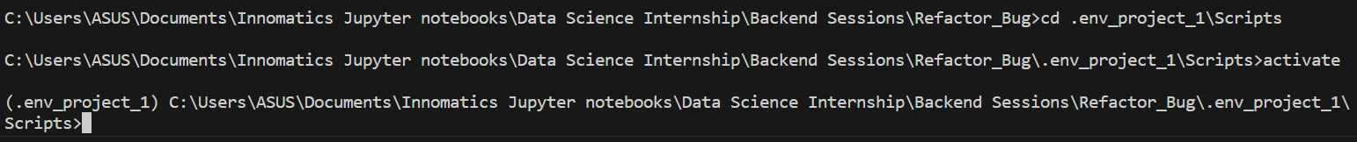
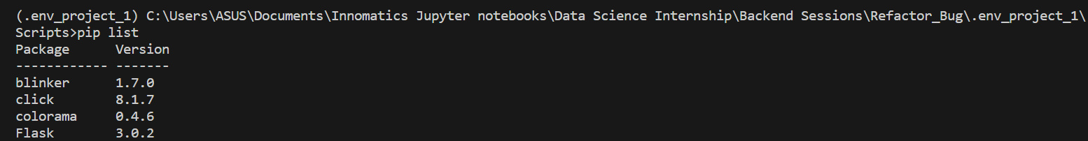
Steps for Code Refactoring and Bug fixing:
Creating a Virtual Environment and installing Flask :

Slide 5
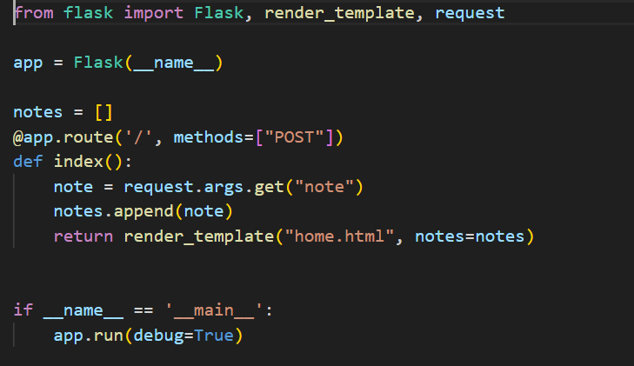
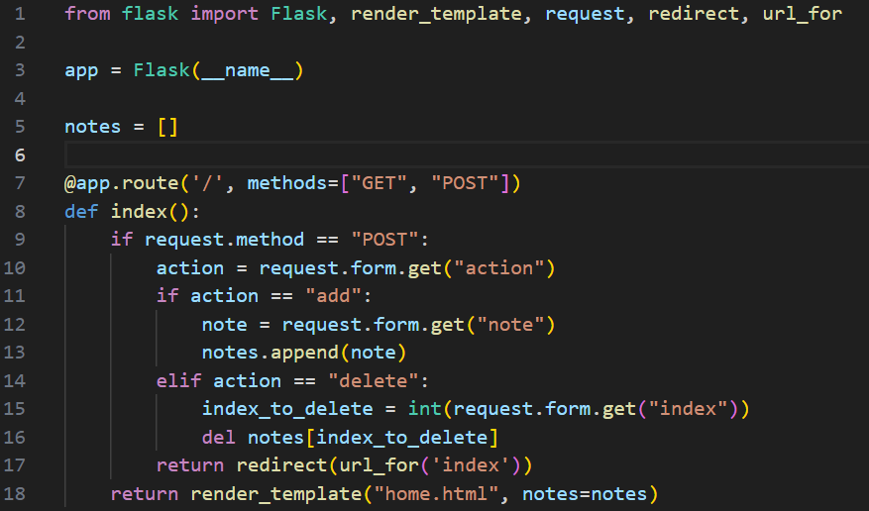
Correcting Bugs in the python code
Before Correction
After Correction

Slide 6
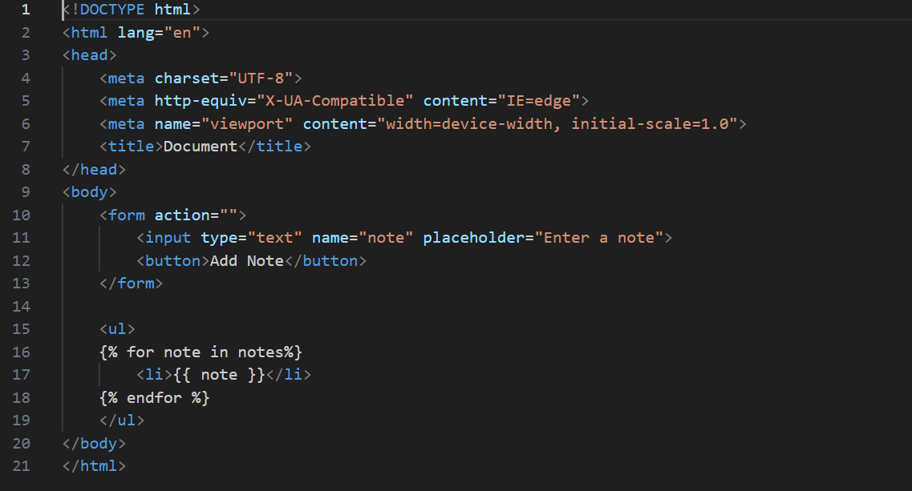
Correcting the Bugs in the HTML Code :
Before Correction

Slide 7
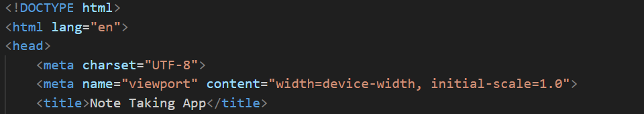
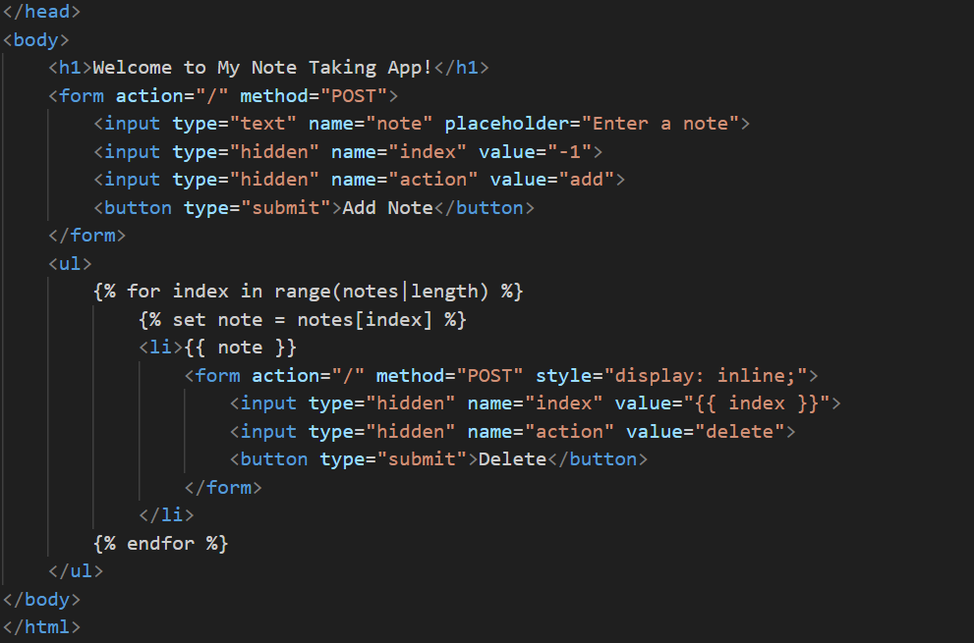
After Correction

Slide 8
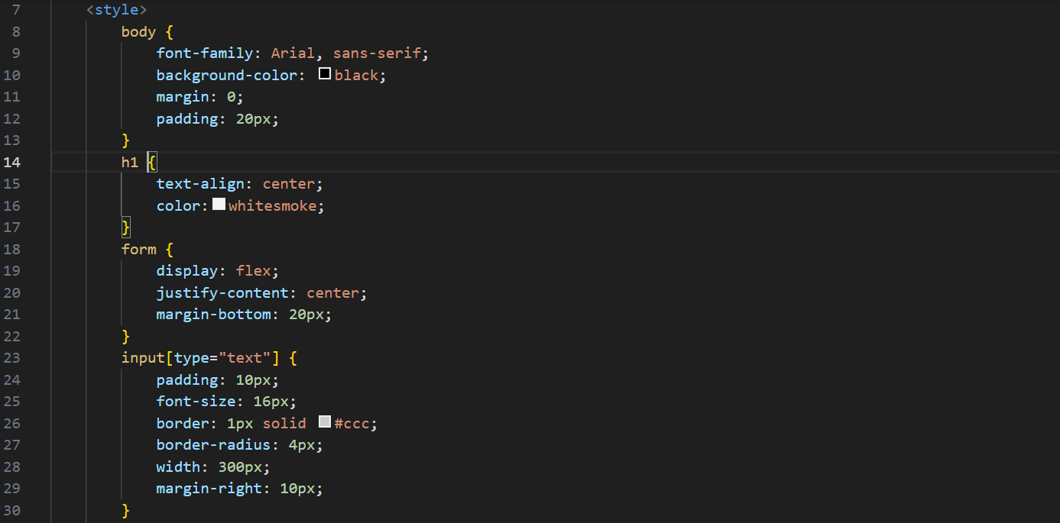
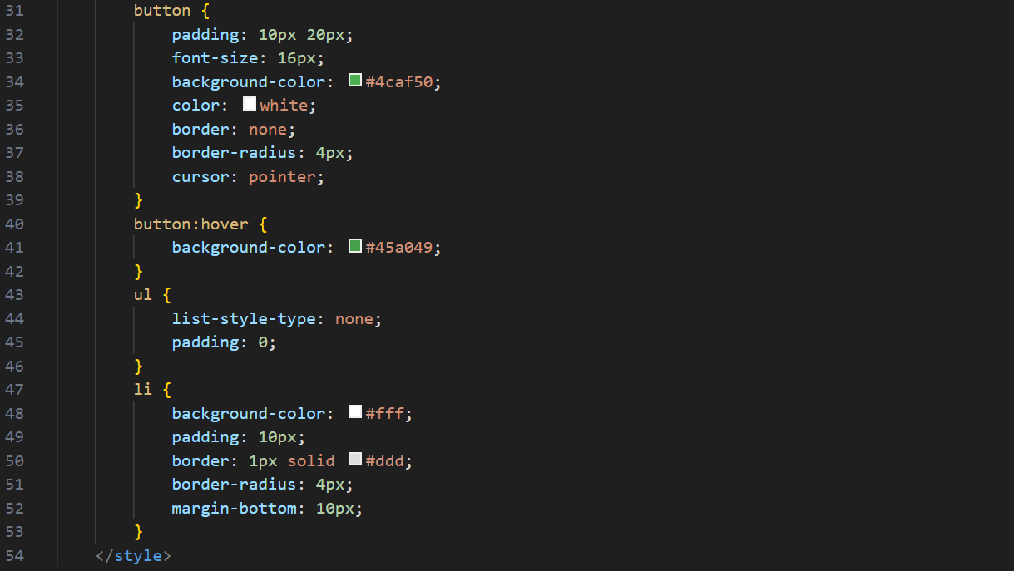
We can add some styles make the website look a little pretty and more user-friendly.
These are some styles I’ve added in the <style> section.

Slide 9
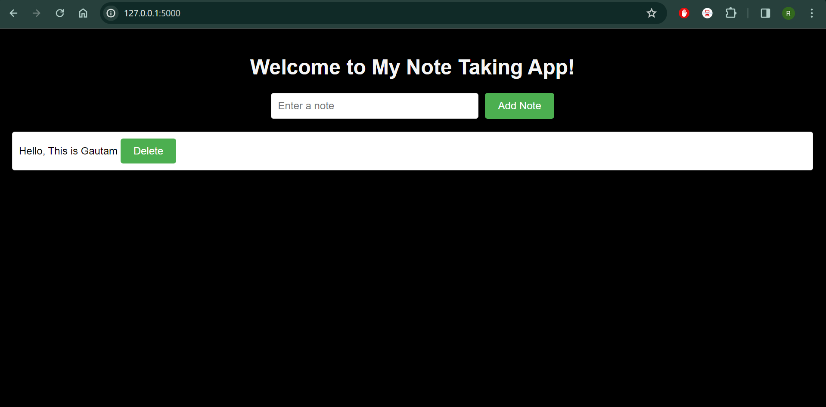
Web-Application

Slide 10

THANK YOU

